Slide 1

Cloud Storage
Talha Khalid
OneDrive – Cloud Storage (Training Session)

Slide 2
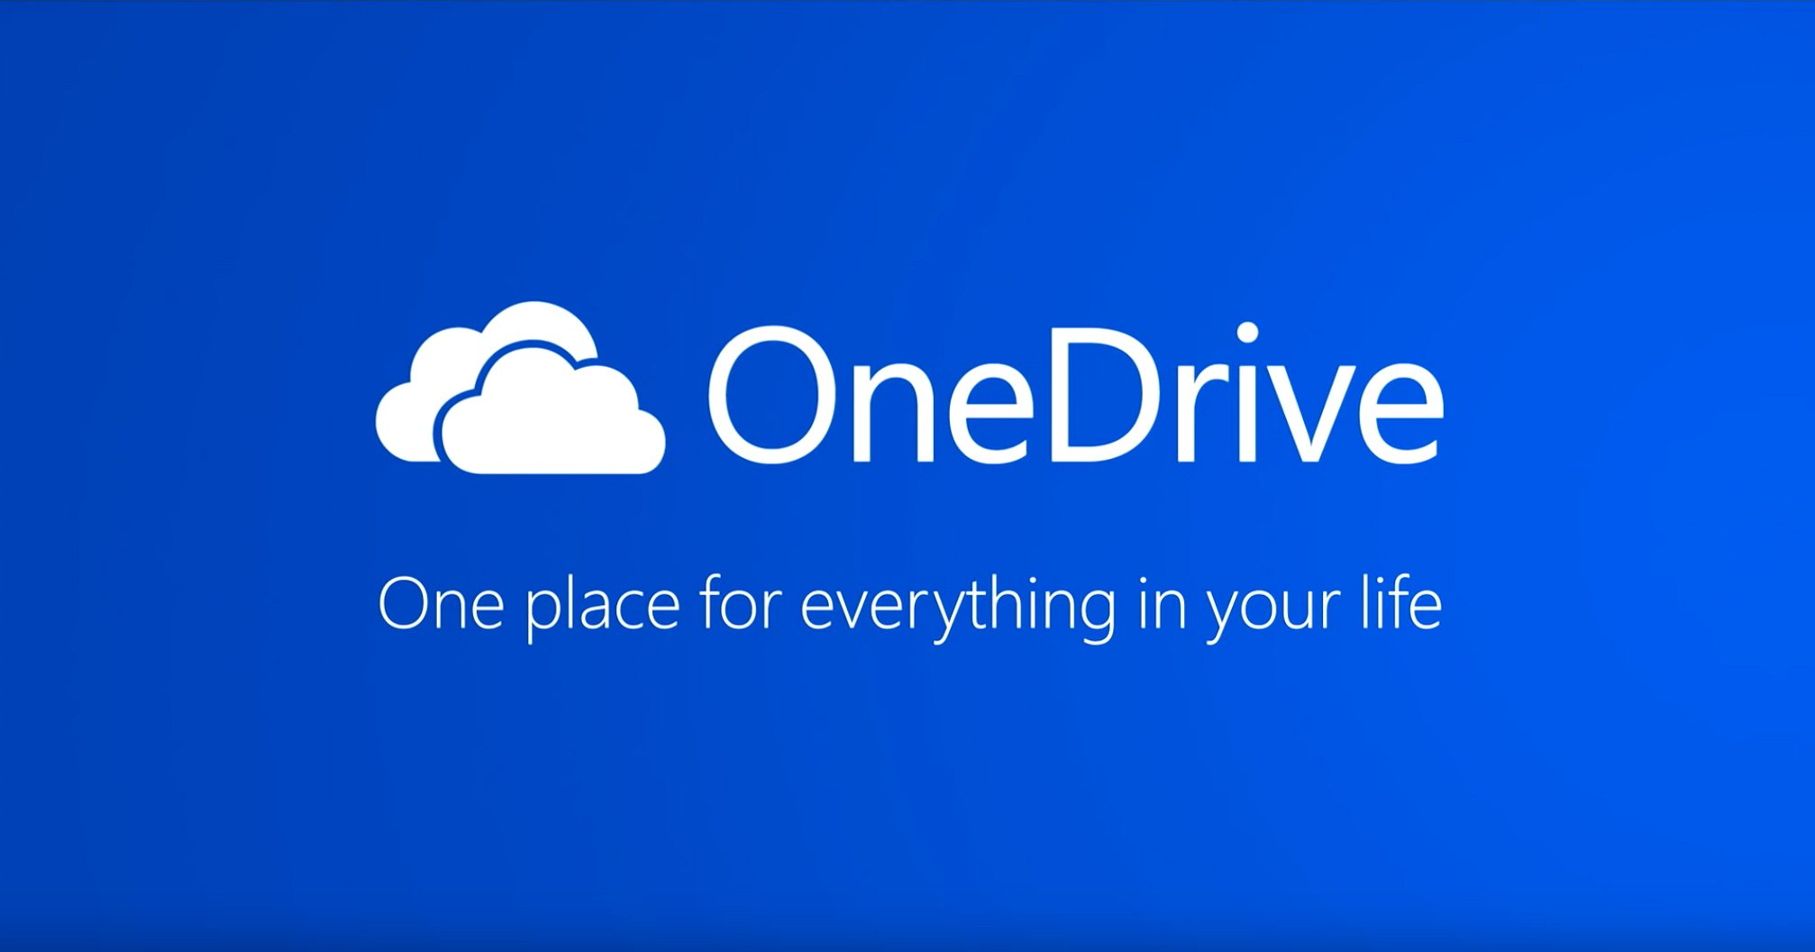

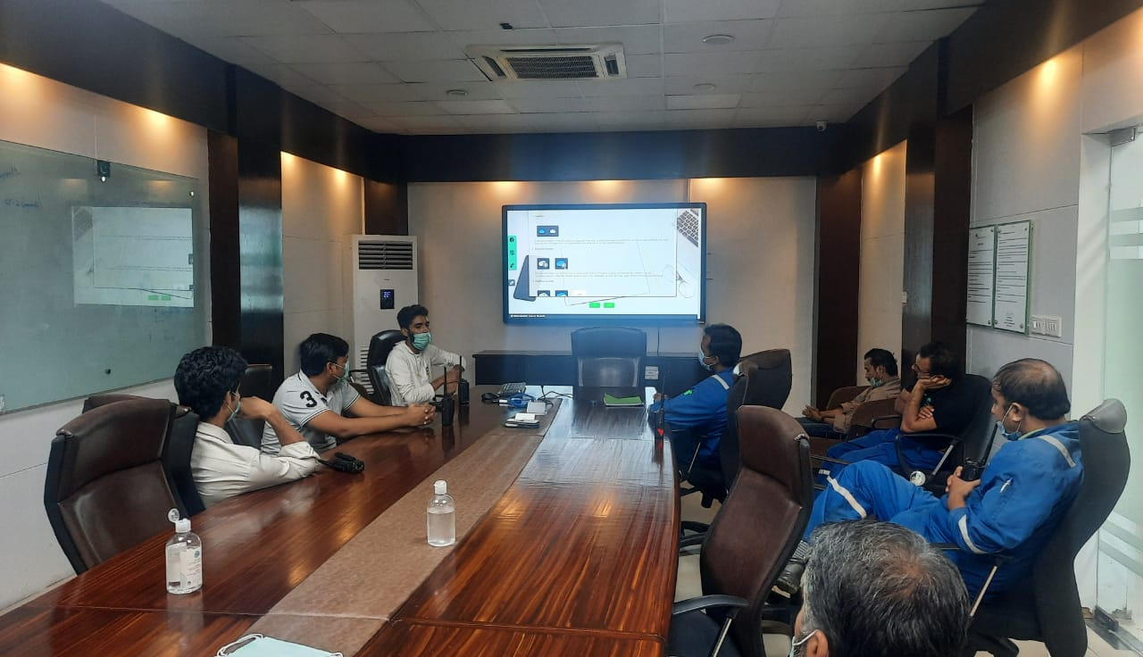
Training – Cloud Storage (Talha Khalid)

Slide 3
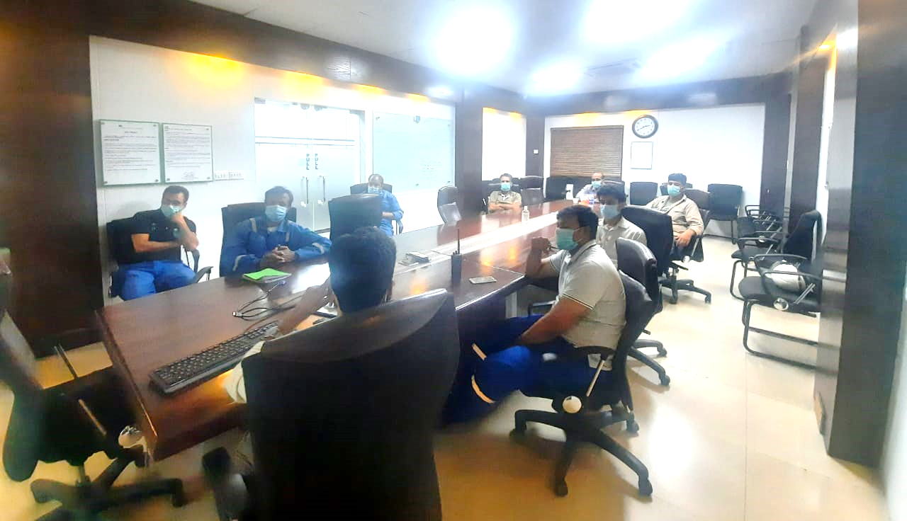
Training – Cloud Storage (Talha Khalid)

Slide 4
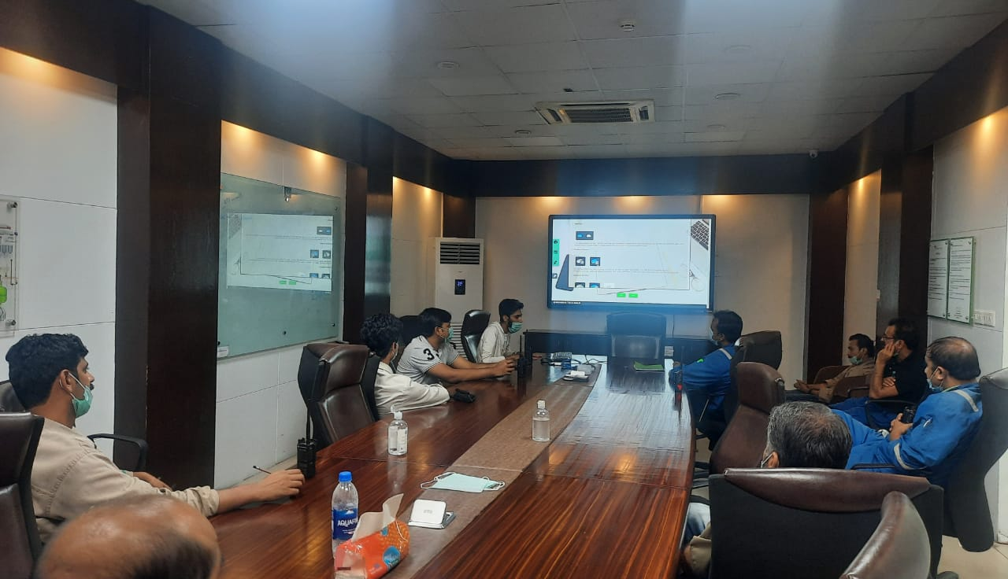
Training – Cloud Storage (Talha Khalid)

